Slide 1
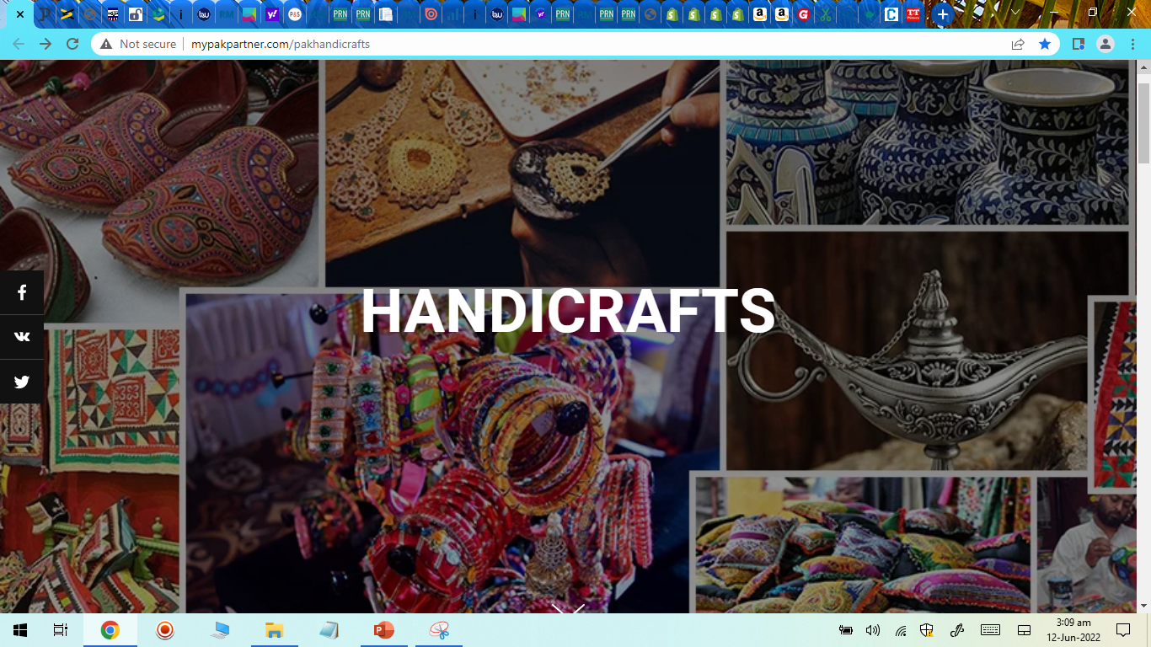

Slide 2
HANDICRAFTS
1. CRAFTS
2. HOME DECOR
3. APPAREL
4. FOOTWEAR
5. ACCESSORIES
A. Functional
A. Home Decor
A. Women Clothing
A. Women Shoes
A. Bags & Purses
Blue Pottery
Ceramics & Pottery
Basketry
Planters
Boxes & Jars
Lamps
Vases & Holders
Pottery & Tableware
Trays & Baskets
Scarfs & Shawls
Unstitched Fabric
Pret, Shirts & Kurta
Hats & Cats
Coats & Uppers
Khussa & Peeptoes
Chappal & Sandals
Pumps & Heels
Clutches & Wristlets
Pouches
Handbags
Shoulder Bags
Wallets
B. Decorative
Camel Skin
Lacquer Art
Wood Craft
Metal Craft
Onyx Craft
B. Men Clothing
B. Jewellery
B. Furnishing
Scarfs & Shawls
Shirts & Kurta
Unstitched Fabric
Hats & Caps
Coats & Uppers
B. Men Shoes
Earrings
Bangles
Necklaces
Rings
Doors & Wall Hangings
Paintings
Sculptures
Furniture
Rugs & Carpets
Peshawari Chappal
Baluchi Chappal
Khussa
C. Fashion
C. Kids Clothing
C. Miscellaneous
Ajrak
Khussa
Paper Mache
Bone Carving
Truck Art
C. Home Textile
Dresses
Kurta & Shirts
Hats & Caps
Sweaters, Coats & Uppers
Phone Covers
Gloves & Mitts
Combs
Cushions
Bed Covers
Blankets & Khess
Tissue Box Covers
Notes:
https://vceela.com/#
https://www.handicraftsinindia.in/
https://folksy.com/
https://dastkarandhra.com/shop/
https://www.craftsvilla.com/

Slide 3
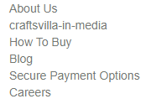

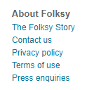


Further headings for main dropdown menu

Slide 4
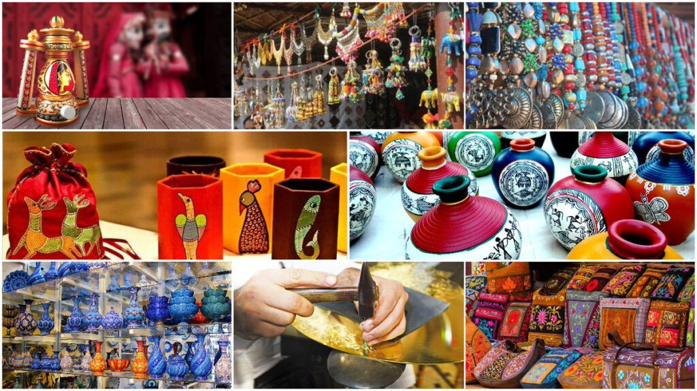
THANK YOU

